Slide 1
Introduction to protein-protein interactions (PPIs) and PPI databases

Slide 2
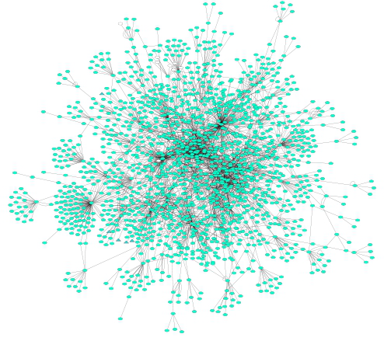
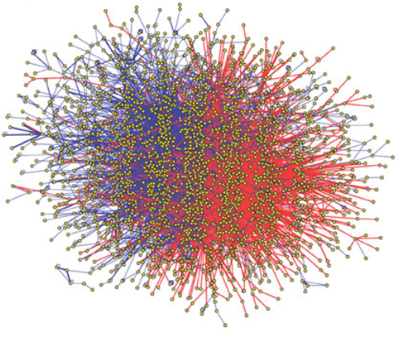
A couple of definitions…
Protein-protein interactions (PPIs): physical and selective contacts that happen between pairs of proteins, in certain molecular regions and in a defined biological context.
Interactome: the totality of PPIs that happen in a cell / in an organism / in a specific biological context...
Protein-protein interaction network: Graphical representation of a group of PPIs in which proteins are represented as nodes and interactions as edges.

Slide 3
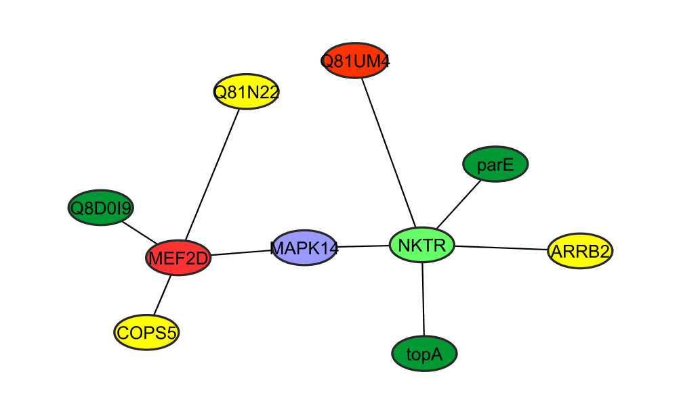
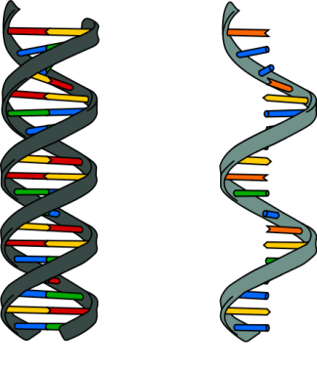
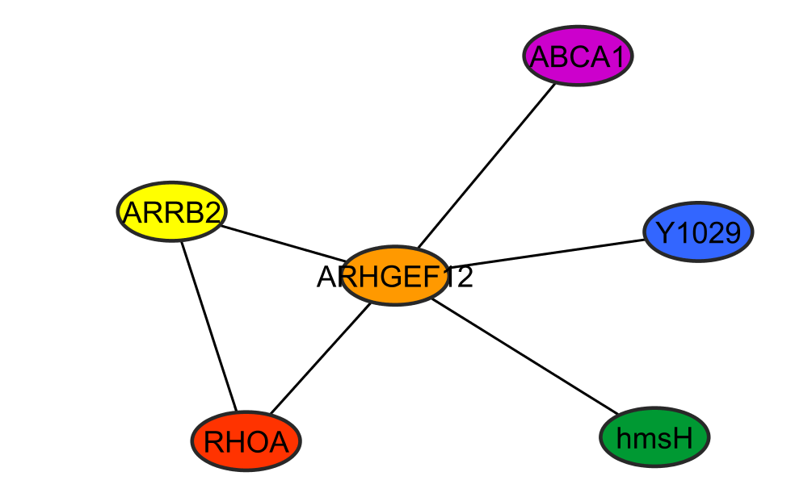
Why protein-protein interactions?
Gene level
Protein level
DNA
RNA
1 protein
=
n functions
=
n networks!
1 protein
=
1 function
WRONG!
To predict a protein biological function
“guilt by association”
proteins with similar functions should cluster together
To improve characterization of protein complexes and pathways
interaction networks work as a draft map that brings detail to biological processes and pathways

Slide 4
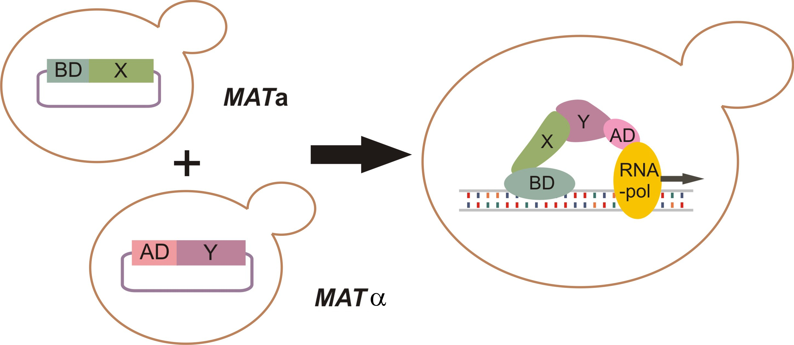
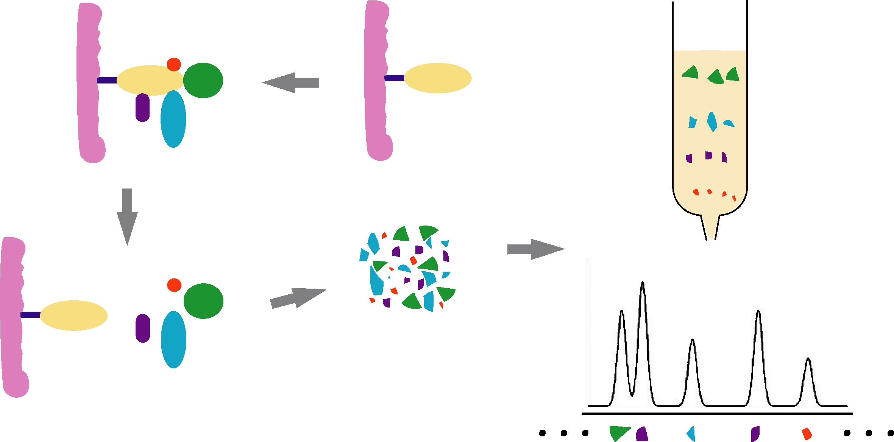
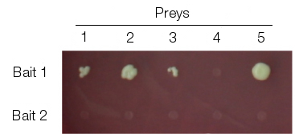
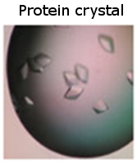
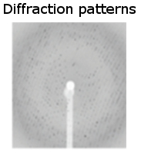
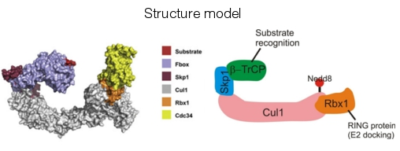
Protein-protein interaction detection methods
Yeast-two hybrid (Y2H)
Tandem affinity purification+ mass spectrometry (TAP-MS)
No single method can accurately reproduce a true binary interaction observed under physiological conditions – every interaction detected experimentally is fundamentally artefactual.
High-throughput
X-ray diffraction studies
Low-throughput
Notes:
There are multiple types of experimental methods used to detect protein-protein interactions. Two methods are important due to their use in high-throughput studies: these are the yeast two hybrid complementation assay (Y2H) and tandem-affinity purification followed by mass spectrometry (TAP-MS). Y2H is a fast, inexpensive and scalable method to detect binary interactions. TAP-MS will detect of multi-protein (n-ary) interactions. Other approaches that are less amenable to high-throughput setups are used in small-scale studies and provide more detailed structural and chemical information about the interaction.
Credits for structure model:
Cullin-complex model from Kleiger et al., Cell 139, 957-968, 2009.

Slide 5
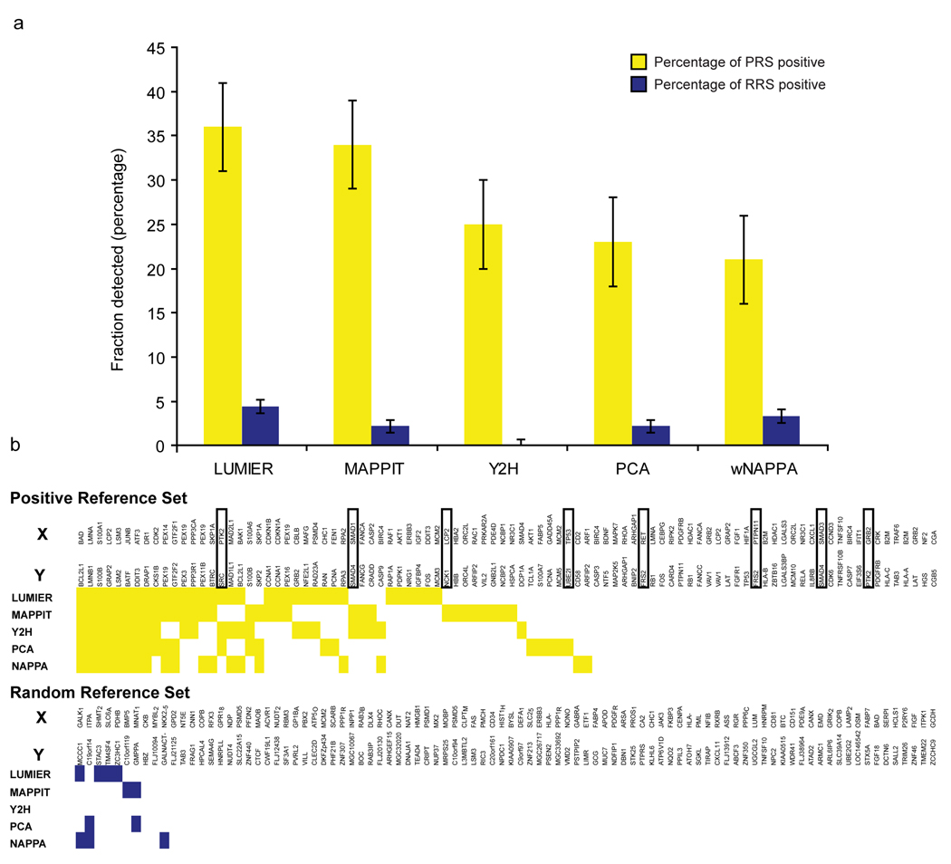
Protein-protein interaction detection methods
Braun et al., Nat Methods, 2008, PMID: 19060903.

Slide 6
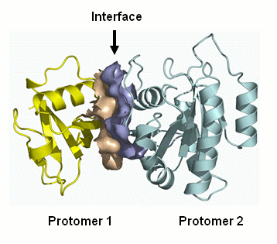
Representing PPIs: interaction domains
interaction domains
Overlap in sequence ranges:
Notes:
We can specifically describe interacting domains down to the residue level.
The domain can be represented as the specific range of the underlying amino acid sequence.
Including required PTM
These ranges are remapped whenever UniProtKB updates their protein sequences.

Slide 7
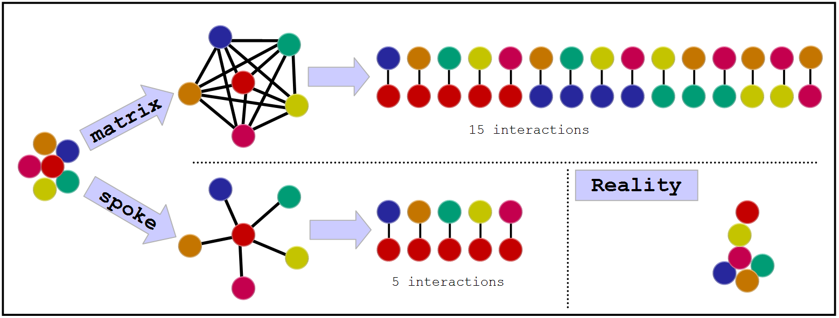
Representing PPIs:
The problem with complexes
Some experimental methods generate complex data: E. g. Tandem affinity purification (TAP)
There are two algorithms to transform this information into binary data:
Notes:
Computational tool to aid searches,
Transforms n-ary interaction into binary,
Both are somewhat wrong, spoke is said to generated 3 times less false positive (Bader et al.).

Slide 8









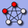

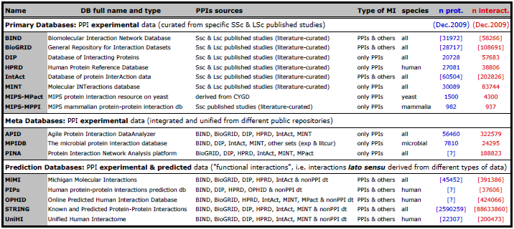
Interactions databases: types
De Las Rivas & Fontanillo, PLoS Computational biology, PMID: 20589078.

Slide 9


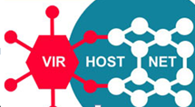





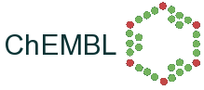




Databases: curation levels
SHALLOW
CURATION
DEEP CURATION

Slide 10
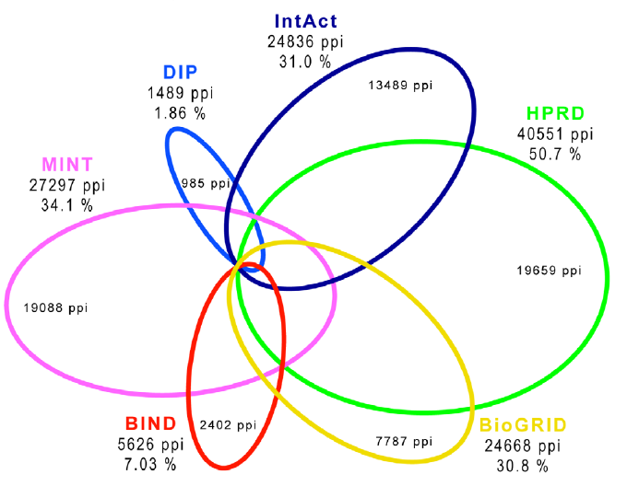
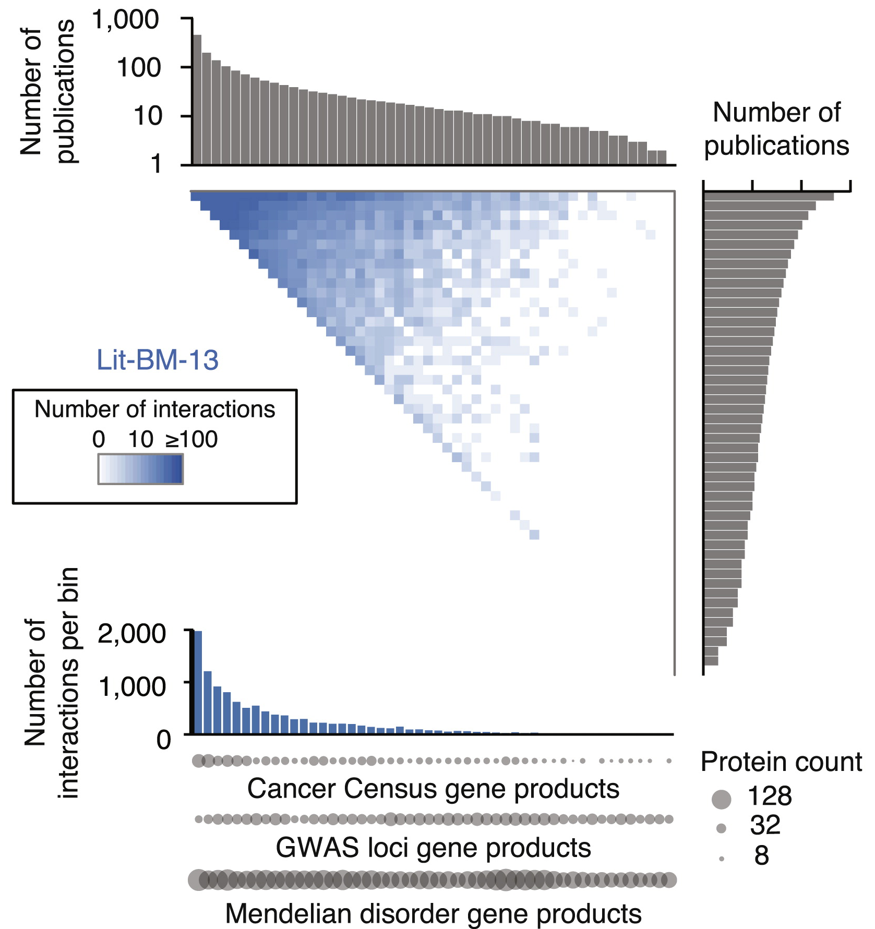
Primary databases: coverage and biases
Human PPIs coverage in the main public primary databases
(Dec 2009)
Popularity bias in publicly available databases
(2013)
Roland et al., Cell, PMID: 25416956.
De Las Rivas & Fontanillo, PLoS Computational biology, PMID: 20589078.

